Slide 1
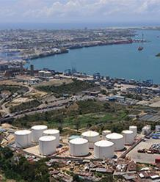
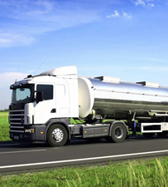
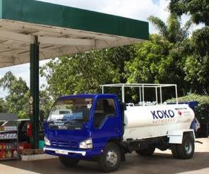
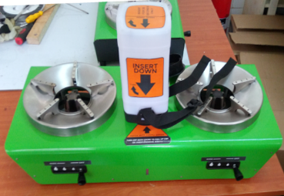
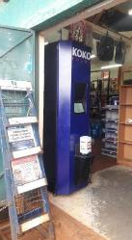

OVERVIEW PILOT PROJECT WITH VIVO KENYA
PROPRIETARY & CONFIDENTIAL
28 Nov 2017
© 2017 KOKO Networks Limited – Proprietary & Confidential

Slide 2
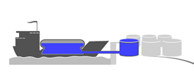
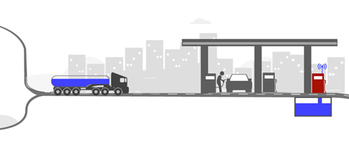




BACKGROUND: KOKO & VIVO ARE DEVELOPING A PARTNERSHIP WHEREBY VIVO WILL BE THE EXCLUSIVE “ETHANOL FUEL WHOLESALER” TO KOKO AGENT SHOPKEEPERS IN KENYA
Global Trader/s
Fuel Wholesaler
Shopkeepers
Regional Plants
© 2017 KOKO Networks Limited – Proprietary & Confidential
Nairobi Network: (mid-2018)
10 Stations
10 MicroTankers
1,000 Shops
2

Slide 3
PILOT OVERVIEW
To enable KOKO and VIVO to prepare for the broader commercial relationship, through installation and operation of KOKO fuel distribution technology at a single Shell station in Nairobi
Bidii Station, Eastleigh, Nairobi
Offloading bulk Ethanol fuel into an Underground Storage Tank at station (managed by KOKO)
Loading Ethanol into KOKO’s MicroTanker using dedicated pump (managed by KOKO)
MicroTanker deliveries to 11 KOKO fuel dispensers around Nairobi (managed by KOKO)
Demonstration of KOKO’s Ethanol distribution technology and operating procedures in action
Identification of required improvement areas (technology design, operating procedures, etc) prior to Hard Launch
Early Dec 2017: Kickoff (agreements, tank conversion, pump set up)
Mid Dec 2017: Launch operations (receive Ethanol, daily MicroTanker loading)
Continue up to 12 months (until Hard Launch operations launched)
OBJECTIVES
LOCATION
PROCESSES
TARGET OUTPUTS
PERIOD
© 2017 KOKO Networks Limited – Proprietary & Confidential
3

Slide 4

OVERVIEW OF PILOT OPERATIONS
Ethanol Plant/s
Tanker
Bidii Station
MicroTanker
Shops
Step 1:
Ethanol procured from local plant
(managed by KOKO)
Step 2:
Ethanol transported directly to Bidii Station in a contracted Ethanol tanker truck
(managed by KOKO)
Step 3:
Ethanol off-loaded into dedicated Underground Storage Tank
(managed by KOKO)
Step 4:
Ethanol loaded into MicroTanker truck as needed to make local milk-runs using dedicated pump on forecourt
(managed by KOKO)
Step 5:
MicroTanker drives to KOKO-point fuel dispensers and safely refills each one via external refilling box
(managed by KOKO)
© 2017 KOKO Networks Limited – Proprietary & Confidential
VIVO involvement in operations will be minimal during Pilot phase
4

Slide 5

SCHEMATIC OF INFRASTRUCTURE
Vapor recovery line
Fill line
KOKO Smart Depot System
KOKO
IoT
Controller
Electronic Valve
MT Liquid Fuel Hose Reel
Vent
Touch screen
Lock
KOKO Smart Tanker System
Flow- meter
Sensor
Offloading Sump
Suction pump
Fill
Check valve
240VAC
Power supply
Manhole
Dome
Underground Storage Tank
© 2017 KOKO Networks Limited – Proprietary & Confidential
5

Slide 6



PROCESS FLOW & INFORMATION SYSTEMS
ACTOR
FUEL SUPPLY MANAGER
MICROTANKER OPERATOR
KOKO CORE SYSTEMS & DASHBOARDS
INTERFACE
“DEPOT MANAGER” Browser-based
“MICROTANKER OPERATOR” Smartphone App
“SMART DEPOT SYSTEM” Touchscreen
DASHBOARDS & ANALYTICS Browser-based
[1] Analyzes inventory levels and creates KP refilling tasks & route
Data for each step is logged allowing for
NOC Alarms in case of problems
Investigation in case of inconsistency
Performance monitoring of operator
Efficiency improvements
[2] Creates Tanker refill Task #1: 500 Litres
[3] Receives Task #1 notification
Ensures Tanker is parked properly at Depot for Refilling Task & unlocks SDS
PROCESSES
Goes through set – up checklist (safety cordon, connect hoses, etc.)
[4] Logs into SDS touchscreen
[5] Confirms display of Task 1: 500 L
[6] Receives update re: Task 1
[7] Ends Task 1 after pumping stops
[6] Presses START to begin pumping
© 2017 KOKO Networks Limited – Proprietary & Confidential
Goes through shut-down checklist
6

Slide 7
PILOT IMPLEMENTATION ACTIVITIES & TIMELIME
Activity Party Date
1. Site visit KOKO Done
2. Preliminary assessment & recommendation KOKO Done
3. Official go-ahead from both sides Joint Done
4. HSE review & planning Joint w/o 27 Nov
5. UST cleaning and retrofitting VIVO w/o 4 Dec
6. Site modifications (bollards, pump, booth,…) VIVO w/o 4 Dec
7. KOKO systems installation & testing KOKO w/o 18 Dec
8. Final inspection & launch Joint w/o 18 Dec

